Slide 1
GGF15 – Grids and
Network Virtualization
Yaron Haviv
yaronh@voltaire.com

Slide 2

Addressing Grid Challenges
Diversity
  Different applications, different machines, different needs
Dynamic
  Shift resources in seconds
Geographically distributed
  Islands of resources in different physical locations
Different expertise domains
  Separate teams managing storage/server/storage
Different admin domains and budgets
  Sharing infrastructure, Security and Accounting challenges

Slide 3
Addressing Grid Challenges
Diversity
  Use common virtual building blocks (divided by functionality Vs. technology)
Dynamic
  Simplify the flow of provisioning resources
Geographically distributed
  Use global routing/naming and location independent technologies
Different expertise domains
  Allow independent management for different resource classes
Different admin domains and budgets
  Granular security, constant resource monitoring and accounting

Slide 4
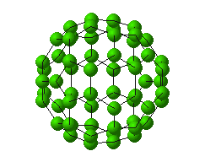
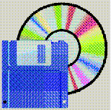


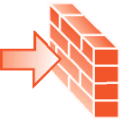
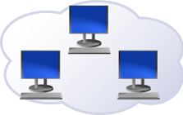

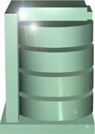
Traditional Grid Deployment and Execution
In typical Grid installations the hardware is not Virtualized, Grid infrastructure manage compute and file staging (Typically in WAN)
Required Tasks
Grid Resource Layers
Deploy, configure and initialize services/applications (optional*)
3
Deploy and configure software packages (optional*)
2
Allocate compute and memory resources from a poll
Memory
1
CPU
CPU
CPU
CPU
Static Hardware configurations
* Image may already contain all required software, properly configured

Slide 5
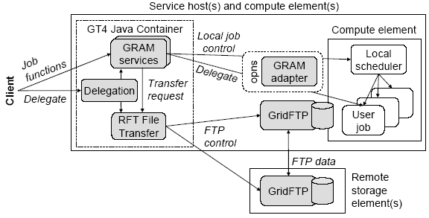

Globus GRAM Example, Limited Provisioning
Client issue a job on a remote machine
Optional file staging and exporting
Manage Job lifecycle
Assume hosts are live and environment is configured

Slide 6
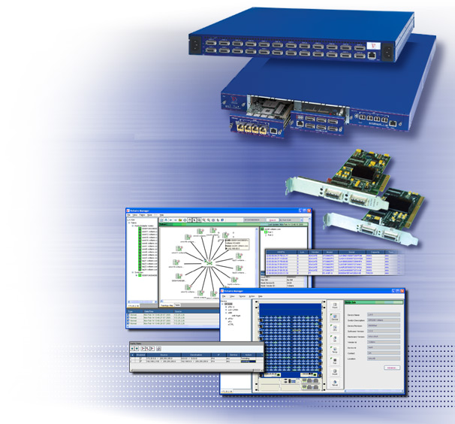
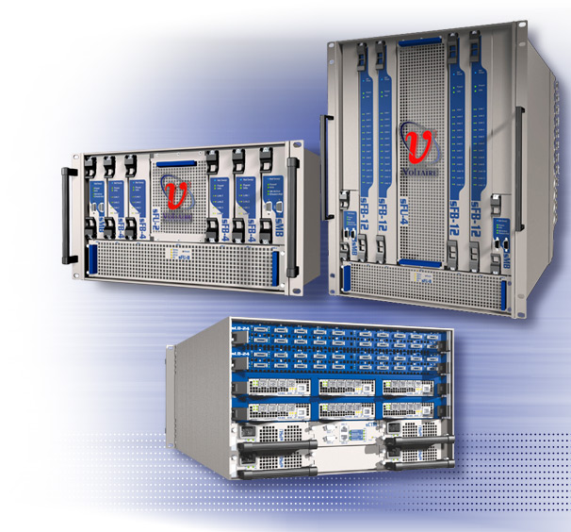
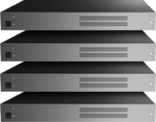
Grid Framework, The Complete Picture
Enterprise Data Center Applications
Grid Middleware
Server
Virtualization Tools
Storage
Virtualization Tools
Management
Platforms
What about the network?
LAN/SAN Infrastructure
Commodity Servers and Storage

Slide 7
Grid Framework, The Complete Picture
Enterprise Data Center Applications
Grid Middleware
Server
Virtualization Tools
Network
Virtualization
Storage
Virtualization Tools
Management
Platforms
LAN/SAN Infrastructure
Commodity Servers and Storage

Slide 8
Physical Server Model (based on CIM)
Physical Server include
  List of disk controllers and disks
  List of NICs/HBAs/HCAs and ports
  One or more OSs/VMs
  And more
  (as defined in CIM)
Physical Server
Disks
Ctrl
NICs
HCAs
OSs/VMs
Disks
Ports
Ports
Logical abstractions needed to simplify Grids
HW Addresses
Partitions

Slide 9


Domains and Logical Servers
Grid
Logical Servers
Virtual Storage
Virtual Networks
SAN
Domain
Domain
Logical
Server
Logical
Server
Logical
Server
Logical
Server
Logical
Server
Domain Example
Empty
VM
Server
Server
VM
Server
(Template)
1:N (VM)
N:1 (Cluster)
1:1
Grid divided to multiple administrative domains
Each domain is a collection of logical servers
  Logical server contain 0 to N virtual or real Machines and attached IO
  Logical servers attach to virtual networks and storage

Slide 10
Logical Server Object and Virtual Connectivity
LAN2
(e.g. External)
Storage Domains (VSANs)
Interfaces
(Virtual NICs)
External Networks
Service Access Points
Lun2
FS
Logical Router
Lun1 (Boot)
LAN1
(e.g. Mng)
Logical Server
LAN Virtualization
  VLANs, Virtual NICs
  Virtual routing
  Service enforcement
LAN & SAN properties associated with Logical Servers rather than Physical
SAN Virtualization
  VSANs (Domains)
  Virtual LUNs, SAN Boot
  Service enforcement

Slide 11
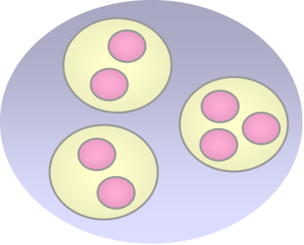
The Virtual Network Objects
Network
Interfaces
(end-points)
Router
Links/Pipes
Services
A Network is a collection of Interfaces (end-points)
  Each Logical Server may have multiple interfaces
Interfaces deliver multiple network services
Links connect networks, interfaces, and services
Routers manage traffic

Slide 12

Links as Grid Resources
QoS:
Bandwidth, Priority
Traffic Monitoring
Layer 3-7 routing
Security
HA, Multipath
Link attributes impact application QoS
Virtualization enable mapping service objectives to hardware:
  Pool or prioritize links to satisfy QoS
  Configure multiple paths to gain high-availability or scalability
  Configure security and routing to match application layout
  Monitor traffic and failure at the service level

Slide 13
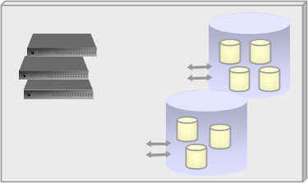
The Virtual SAN Object
Virtual SAN
Target
LUNs
Other VSAN
Target
Logical Servers (Initiators)
Portals
Router
Following the iSCSI/iSNS Model (extended to other fabrics)
  Each Virtual SAN (Domain) contains Initiators and Targets
  Targets can be Virtual or Physical, divided to LUNs
  Each target/initiator has one or more portals (access points)
  SAN Routers can connect different VSANs

Slide 14
SAN Link Attributes
Traffic Monitoring
Storage Virtualization
and routing
QoS
Target
LUNs
Logical Server (Initiators)
Security
HA, Multipath
Storage connectivity impact application QoS
SAN Virtualization enable mapping all resources to a global pool
  Regardless of technology (FC, iSCSI, S-ATA, InfiniBand, ..)
  Regardless of physical location of clients and storage
And control the connectivity/allocation from the service perspective

Slide 15
Example: Provisioning Resources for a 2 Tier Domain
Physical Pool
3. Define Logical Router
Properties (optional):
Physical Servers
VLANs=Work1
Virtual IP = .. (auto)
ACLs = .. (auto)
Bandwidth = …
4. Assign Physical Resources
Decommission
Domain xxx
1. Create new domain:
Name: xxx
Shared Network: Mng
Default Storage: “rescue disk”
work1
backend
Name: Web cluster
Networks: work1, backend
Storage: “web image”
Name: DBsrv
Networks: backend
Storage: “db image”, “db raw”
2. Create Logical servers:

Slide 16
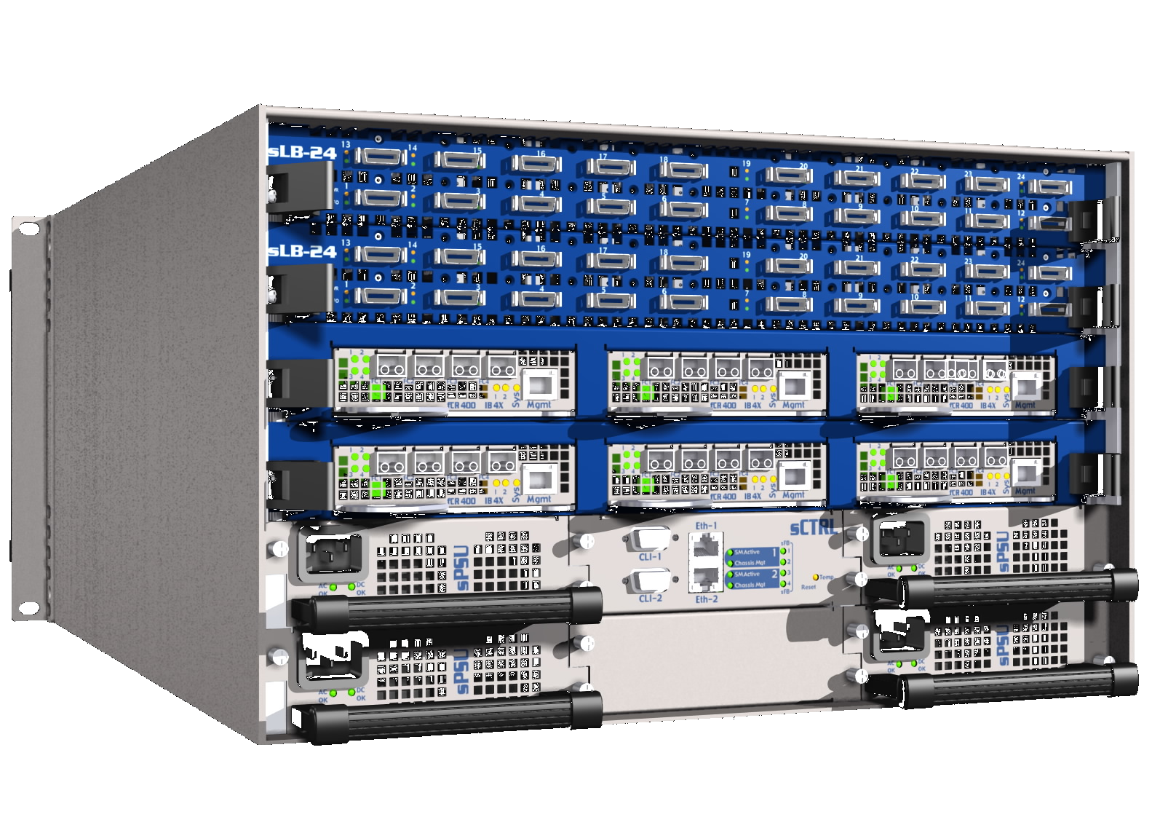
Network Virtualization Advantage – VM Example
Provide resources to VMs, rather than to its physical host
  Based on logical identifiers
  rather than Port MACs
Migration shouldn’t require
network reconfiguration !
Failures/Statistics
need to map to the
logical entities
VM1
VM2
VM3
VMM
VMM
X
GbE
Boot1
LAN1
Switch
Boot2
LAN2
Boot3

Slide 17

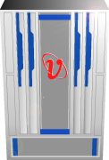



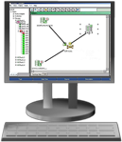
Simplifying Large Scale High-Performance Grids
Edge Switches
Virtualizing fabric resources
Enabling scalability and efficiency
Core Switches
External Networks
IB
Programmable Non Blocking Fabric
GbE
External Storage
1000’s of Nodes
Wired-once, Managed as a resource pool

Slide 18


Grid Service/Task Life Cycle
Policy
Init/
Destroy
Service Requests
(task, capacities, SLO)
Orchestration
Resource Managers
Resource Managers
Deploy
Grid
Resize
Billing
Billing & Accounting
Monitors & Filters
Monitors & Filters
Sensors

Slide 19
Complete Grid Management Model
Tasks
Policy
Billing
Grid Resource Layers
Grid Management
Orchestrator / Resource Broker
Application / Service RMs
Running services
Policy
Scheduler
Software / License RMs
Software & Licenses
User management
Configuration Management
Compute RM
Memory
CPU
CPU
CPU
CPU
WS-RF
Network RM
Fabric Resources
Discover, Monitor
RM = Resource Manager
Deploy, Configure, Manage

Slide 20
Summary
Virtualization enable Grids and scalability
Networks can be managed as another Grid resource
  Uniform object model across heterogeneous hardware
  Allow allocating LAN/SAN resources on demand
  Scalable model for simple and efficient provisioning
  Monitor overall status/activity at the service level
Network Virtualization is critical to the adoption of Grids in the enterprise and enable simple management of large scale Grids in real world environments

